Slide 1
Food and Beverage Management
The sixth edition
Chapter 3
Product Development

Slide 2
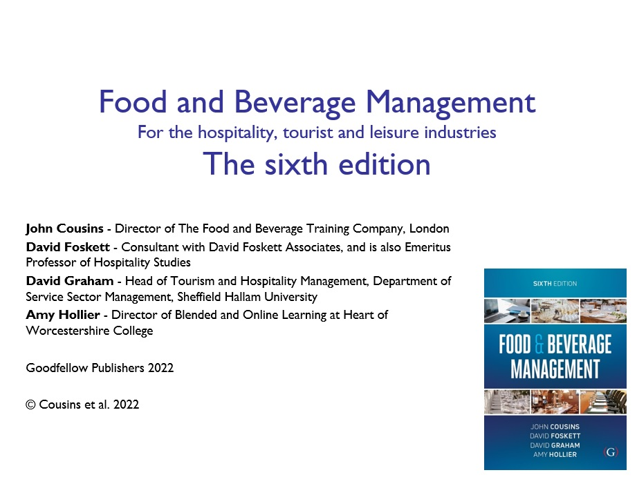

Slide 3
Chapter 3 covers:
The food and beverage product
Quality in the management of food and beverage operations
Creating the consumer–product relationship:
  Determining promotional channels
  Estimating profitability
  Planning product launch
  Offering product and appraising performance
Sales promotion
The consumer–product relationship as a dynamic process

Slide 4
The food and beverage product
Is what operators construct and provide
Marketers tend to identify the product as a central consumer concept known as:
  the core concept
  a surrounding layer of tangible features, and
  and an outer layer of augmentation

Slide 5
Core, tangible and augmented product
The core product is, e.g. a wedding celebration
The tangible product is a full wedding banquet
The augmented product includes e.g. the opportunity to pay by instalments
It is also helpful to apply this framework when developing new concepts

Slide 6
The meal experience
Concept first put forward in the 1960s (Campbell-Smith, 1967)
The experience concept, across a range of service industries, is often referred to as the ‘servicescape’ (first introduced by Bitner, 1992), and broadened to include social interactions (Line et al 2018)
The ‘experiencescape’, is a holistic conceptualization consisting of social, cultural, sensory, functional and natural components that are all present in the dining experience and work together to create the overall meal experience (Pizam and Tasci, 2019)

Slide 7
The five meal experience factors
  Food and beverages on offer
  Level of service
  Level of cleanliness and hygiene
  Perceived value for money and price
  Atmosphere of the establishment
The five elements meal experience provide a way to examine the service offer
The importance of these factors to the customer changes depending on the needs they have at the time

Slide 8
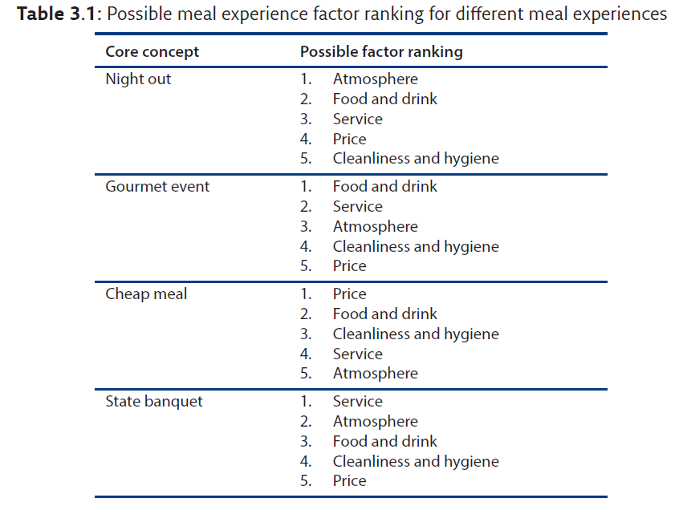
Different meal experience rankings

Slide 9
Food and drink
Provision must focus on the needs and demands of the consumer
Customers construct a package to suit their own needs
Customer needs are diverse
Trying to satisfy everyone leads to satisfying no one

Slide 10
Level of service
Service is a part of the product
Service includes the human interface between the product and the consumer
Human interaction delivers benefits to the customer
Service needs to be designed into the product
Service is a balance of conviviality and efficiency

Slide 11
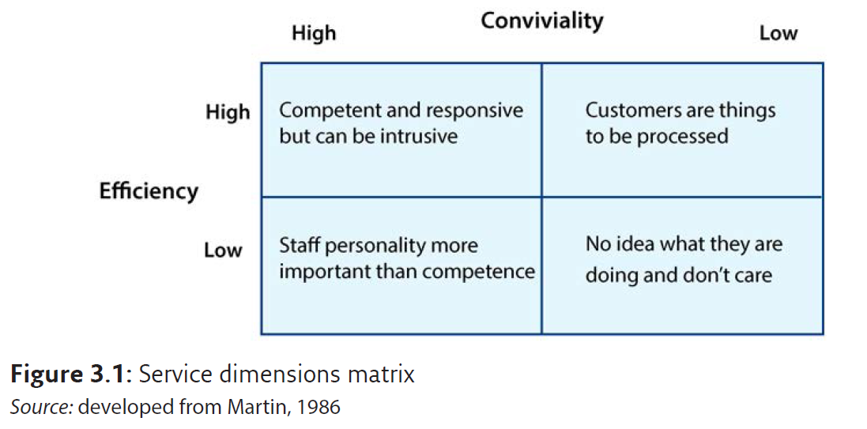
Service dimensions matrix

Slide 12
Cleanliness and hygiene
Premises, equipment and staff
Increased media focus
Customers are now more aware
Essential to ensure proper levels maintained at all times

Slide 13
Price and value for money
Price relates to value, and is directly related to profitability
Prices should create a quality and value perception
Need to establish the price range:
  of potential customers
  in which the operator can provide the products

Slide 14
Cost to a customer is not just the price
Cost also includes:
  not being able to go somewhere else
  transport costs
  time
  having to look and behave certain way
  the efforts to each the money to pay
  risk of disappointment

Slide 15
Value a personal judgement
Good value is where the worth is perceived as greater than the costs
Poor value is where the costs are perceived as greater than the worth

Slide 16
Various pricing methods
Cost plus
Prime costing methods
Backward pricing
Rate of return
Profit-per-customer
Elasticity of demand
Competition comparison

Slide 17
Pricing objectives might include:
Sales volume maximization
Market share gain
Profit maximization
Market penetration

Slide 18
Atmosphere
Created through the combination of factors such as:
  Design
  Décor
  Lighting
  Heating
  Furnishings
  Acoustics and noise levels
  Other customers
  The staff and the attitude of the staff

Slide 19
Quality management
The term ‘quality’ is currently used in a variety of ways to mean a variety of things
The term ‘quality’ used here, is based on British Standard Quality Award BS EN ISO 9001
  ‘in the fitness for purpose and safe in use sense: is the service provided or product designed and constructed to satisfy the customer’s needs’

Slide 20
Aspects of food service operations
Useful to consider specific aspects of the food service operations that are to be managed
These are:
  Technical and service standards
  Customer service and resource productivity
  The nature of service

Slide 21
Level of service : Standards of service
Level of service
  very limited to complex with high levels of personal attention
Standards of service
  measure of how well the operation deliverers the service level it is offering

Slide 22
Level of customer service
Written statements of both:
  Technical specification
      physical characteristics of the products
  Service specification
      procedures and the way they are carried out
Often called the ‘customer service specification’
Need for balance between maintaining customer service and resource productivity

Slide 23
Providing customer service
A combination of five characteristics:
    Service level
    Service availability
    Level of standards
    Service reliability
    Service flexibility
The ‘customer service specification’ must take these into account

Slide 24
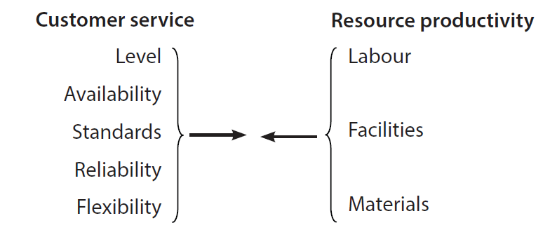
Customer service/resource productivity

Slide 25
Nature of service
Providing service is not just about doing the job
Need for emotional value to be added
Has to be done with the right:
  attitude
  degree of sincerity
  amount of concern for the customers

Slide 26
British Standard EN ISO 9001
Identifies the systems, procedures and criteria that ensure that a product or service meets a customer’s requirements

Slide 27
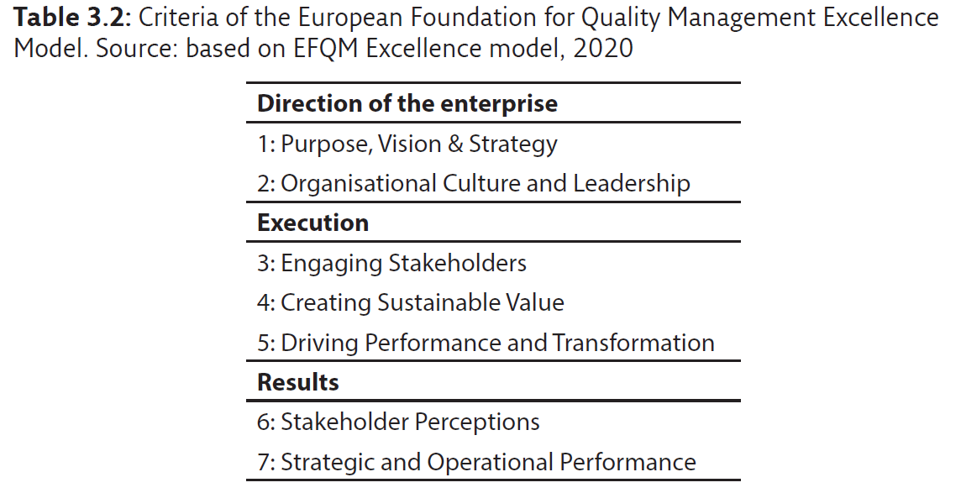
European Foundation for Quality (EFQM)

Slide 28
Hospitality Assured
Many quality assessment processes do not include some external measure of the customers’ satisfaction
For the hospitality industry, there is an accreditation programme that does take into account a measure of the reality of customer service
This programme is Hospitality Assured

Slide 29
Towards an integrated approach
Taking account of:
  the various approaches to quality management
  the place of standards within it
  the scope for developing a relationship between the organisation and the customer
The various ideas can be brought together to develop an integrated approach to service quality management as a six-stage process

Slide 30
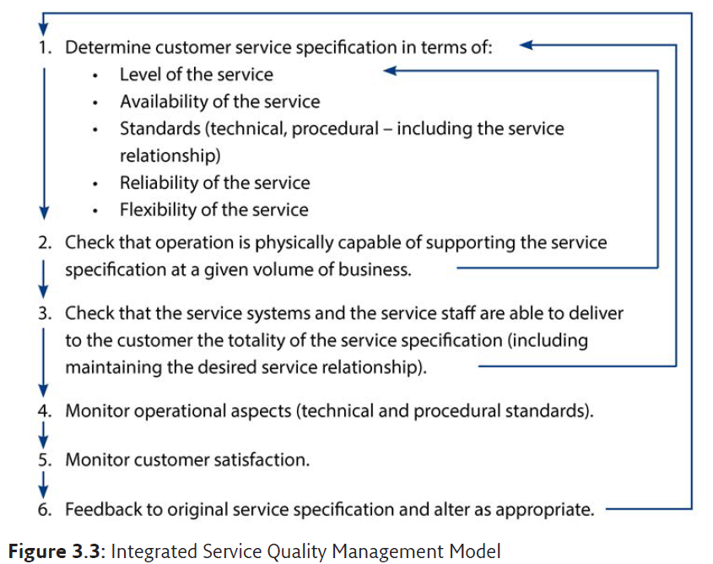
Service Quality Management

Slide 31
Consumer product relationship
Final stages of development:
  Determine promotional channels
  Estimate profitability
  Plan product launch
  Offer product and appraise performance

Slide 32
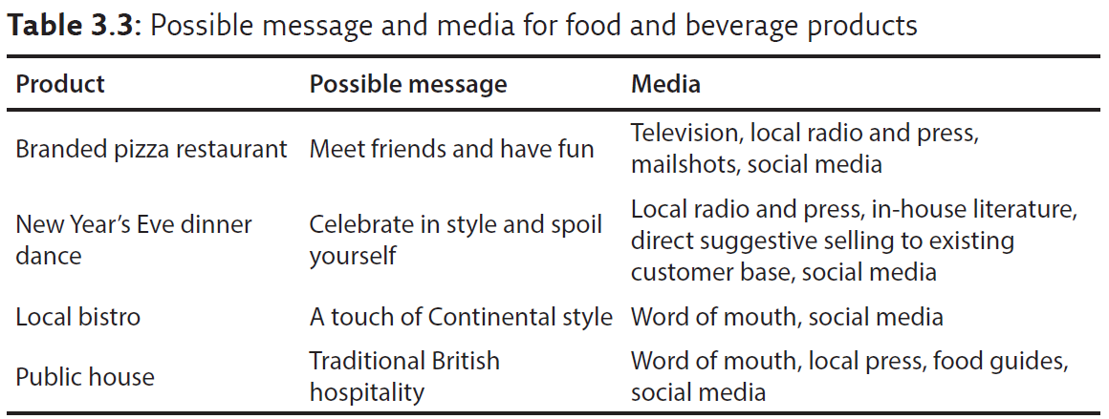
Possible message and media

Slide 33
Websites
An organisation’s website is often the first stop for consumers
Operators need to ensure that their websites are:
  Easy to use
  Intuitive
  Presentable
  Communicative
  Current
  An honest reflec­tion of what is offered

Slide 34
Websites are also platforms to:
Stay contact with customers through blogs and comments
Receive reservations
Third-party booking sites (restaurant marketing portals) provide the opportunity to source bookings and to promote and monitor customer experiences. See for example: Opentable.com

Slide 35
Web-based applications
To distribute, promote, monitor and stay connected with customers and potential customers
Includes:
  User-generated content on website such as: Tripadvisor, Facebook and Twitter, blogs, social networks, metaverse, podcasts, custom apps and RSS

Slide 36
Challenges
No way to govern what happens externally
Operators constantly have to monitor
Anything can be posted and users expect operations to do the same
Very customer driven

Slide 37
Essential considerations
Develop robust social media policy
Follow agreed response protocol
Encourage contributions
Review content
Remember legacy of content

Slide 38
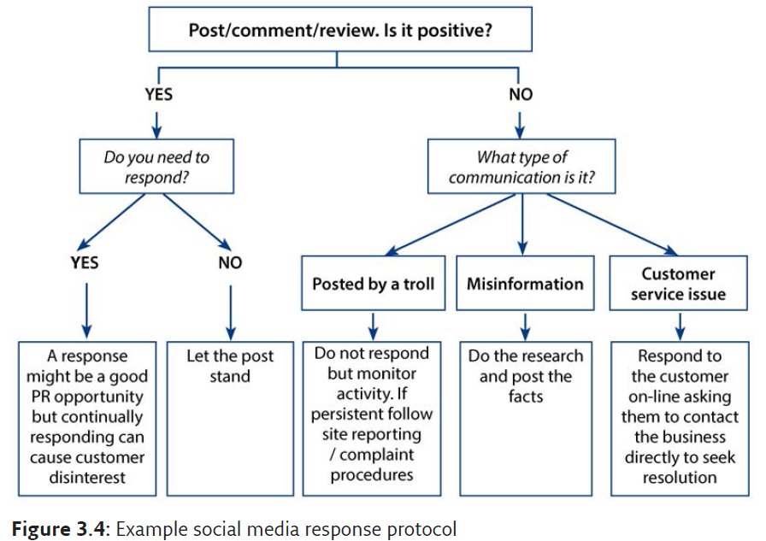
Example response protocol

Slide 39
Customer relationship management (CRM)
CRM is an essential tool for business to:
  Manage customers’ contact information, customer relationships and retarget past customers
  Help to segment customers based on their previ­ous interactions, membership of a loyalty programme, or other demographic data
  Provide a comprehensive way to monitor email campaign data
Some CRM tools can also monitor what people are saying about the business.

Slide 40
Estimating profitability
Predicting outcomes is extremely imprecise, although methods used can be very sophisticated
Applying ‘profitability on sales percentage’ approach will determine the budgeted profit but cannot be guaranteed to be correct
Best and worst scenarios should be considered

Slide 41
Types of costs
Fixed costs, such as rent, rates and insurance premiums, have to be paid even if there is no business
Variable costs, such as meal ingredient and beverage costs, increase as the level of business increases
Semi-variable costs (or stepped costs) have no direct relationship between the level of business and the variable costs

Slide 42
Costs, sales and profit
Total costs are the fixed costs plus the all variable costs
Total sales is the total cash revenue
Break-even point is where the sales revenue exactly equals the total costs
Net profit is sales less total costs.
Level of safety increases when proportion of variable costs is greater than the fixed costs

Slide 43
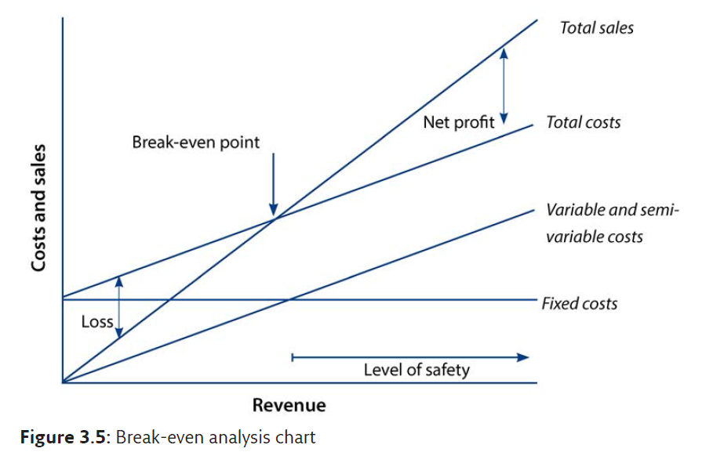
Profitability: Break-even analysis

Slide 44
Planning the product launch
Operationally, the new food and beverage product needs testing
Promotional opportunities include:
  Offering the product free, or at reduced prices, to selected groups on a one-off basis (shake out events’ or ‘soft openings’)
  Introducing special offers to attract customers
Other considerations are:
  Taking account of potential fluctuations of demand
  Delaying a launch rather than offering a sub-standard product
  Appraising the performance (covered in Chapter 9)

Slide 45
Sales promotion
Short-term incentives designed to change the buying habits of customers and increase the revenue of the operation
To directly encourage the customer to purchase, often through short-term improvements in the cost–value ratio

Slide 46
Sales tactics
Ensure all pricing is clear
Never discount - package instead
Create special promotions
Have well trained staff so they can sell
Apply standard customer procedures
Seek customer loyalty and feedback
Concentrate on promoting value
Cash profit maximisation
Reposition

Slide 47
Merchandising activities
Marketing
Advertising
Point-of-sale selling
Aimed at improving profitability
Staff recognition of customer needs
Using design
Making the customer feel distinctive and unique
Making customers feel valued and encouraging loyalty
Achieving customer satisfaction

Slide 48
Personal selling
Staff should be able to:
  Describe the food, wines and drinks on offer in an informative and appealing way
  Use opportunities to promote specific items or deals when taking customer orders
  Seek information in a way that promotes sales
  Provide a competent service
  Seek customers’ views

Slide 49
Consumer-product relationship
Process has to be dynamic
Customer needs change
Market research needs to be continual
Need to review current concept against new ideas and concepts
Business and product life cycles are becoming shorter
Managing change is complex
Businesses must have a clear vision

